Slide 1
NodeJS- Understanding Node.js, Installing Node.js
M.SATHVIKA REDDY
22H51A05A2
CSE-D
Notes:
Line spacing + Page numbers

Slide 2
Agenda
01 Introduction
02 Installing
03 applicatioon
04 Conclusion

Slide 3
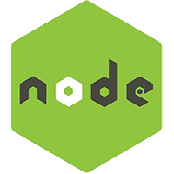
Introduction
01
Node.js is an open-source and cross-platform JavaScript runtime environment. It is a popular tool for almost any kind of project!
Node.js runs the V8 JavaScript engine, the core of Google Chrome, outside of the browser. This allows Node.js to be very performant.
A Node.js app runs in a single process, without creating a new thread for every request. Node.js provides a set of asynchronous I/O primitives in its standard library that prevent JavaScript code from blocking and generally, libraries in Node.js are written using non-blocking paradigms, making blocking behavior the exception rather than the norm.

Slide 4
When Node.js performs an I/O operation, like reading from the network, accessing a database or the filesystem, instead of blocking the thread and wasting CPU cycles waiting, Node.js will resume the operations when the response comes back.
This allows Node.js to handle thousands of concurrent connections with a single server without introducing the burden of managing thread concurrency, which could be a significant source of bugs.
Node.js has a unique advantage because millions of frontend developers that write JavaScript for the browser are now able to write the server-side code in addition to the client-side code without the need to learn a completely different language.
In Node.js the new ECMAScript standards can be used without problems, as you don't have to wait for all your users to update their browsers - you are in charge of deciding which ECMAScript version to use by changing the Node.js version, and you can also enable specific experimental features by running Node.js with flags.

Slide 5
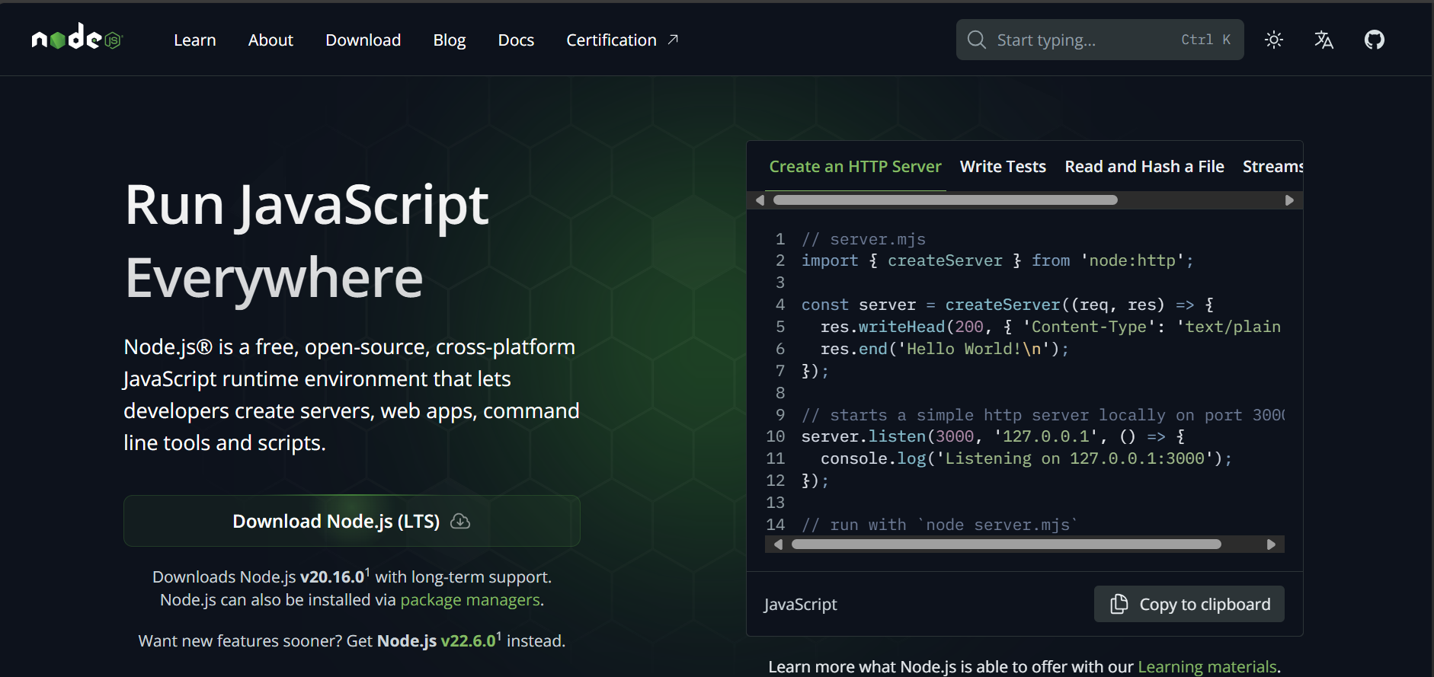
Installation
02
Search for node js
Open Node.js — Node.js — Run JavaScript Everywhere (nodejs.org)

Slide 6
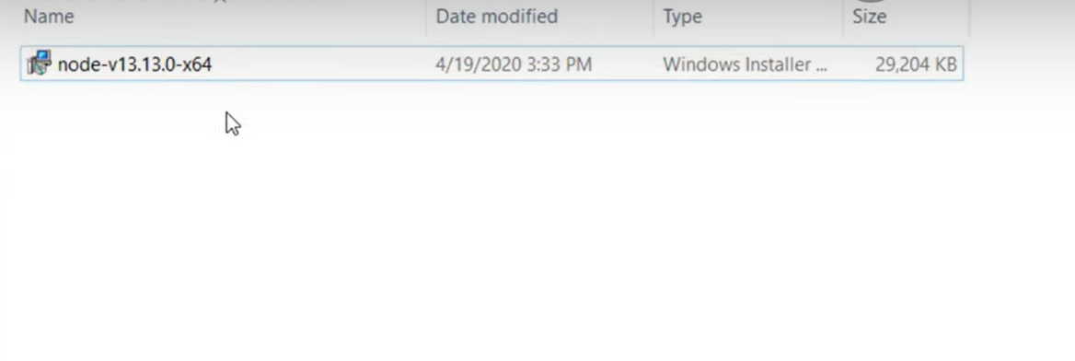
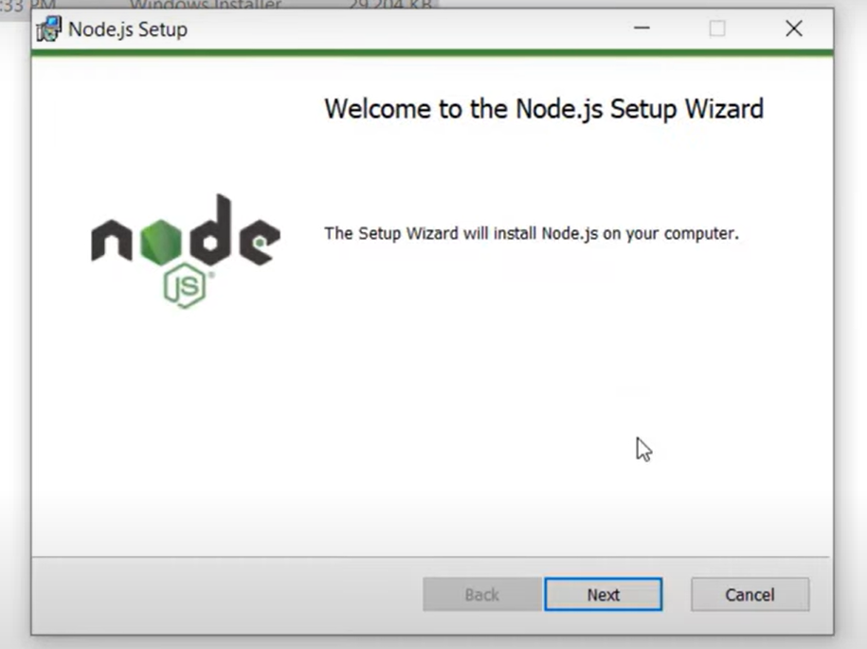

Slide 7
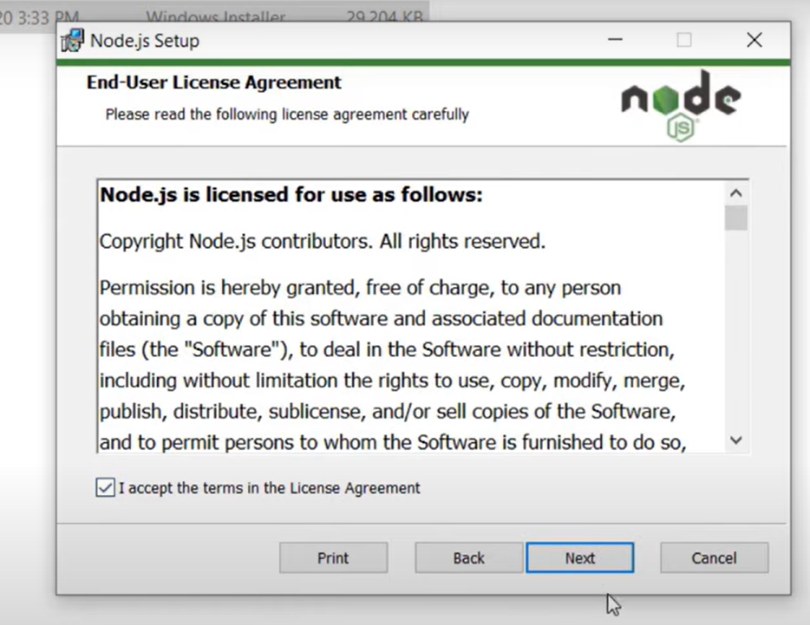

Slide 8
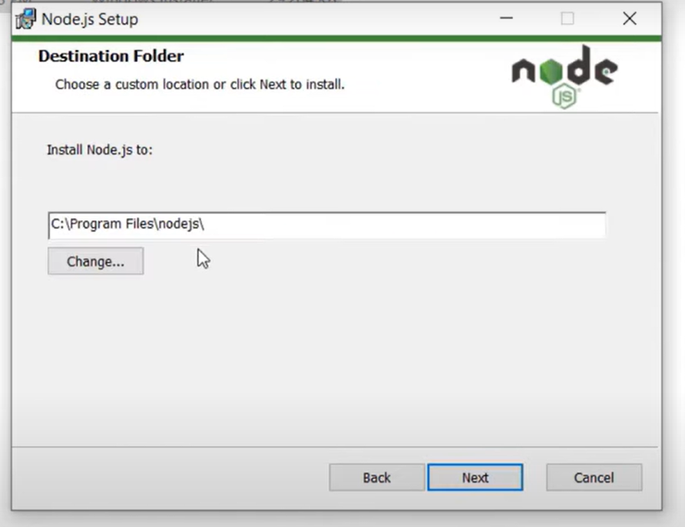

Slide 9
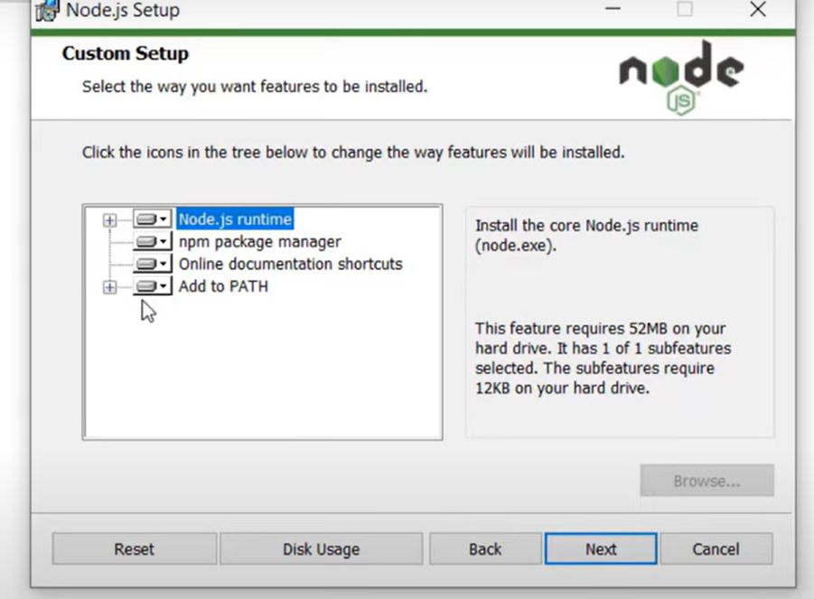

Slide 10
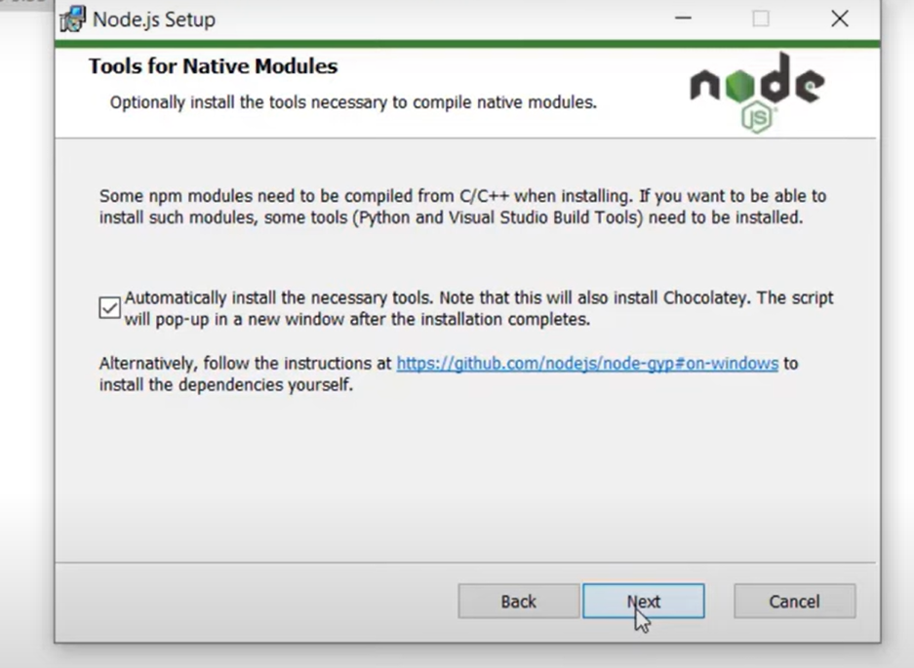

Slide 11
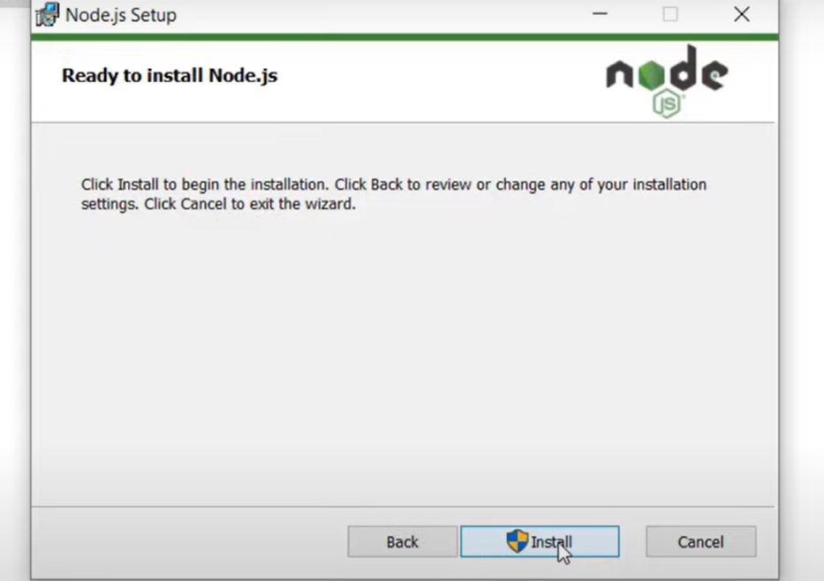

Slide 12
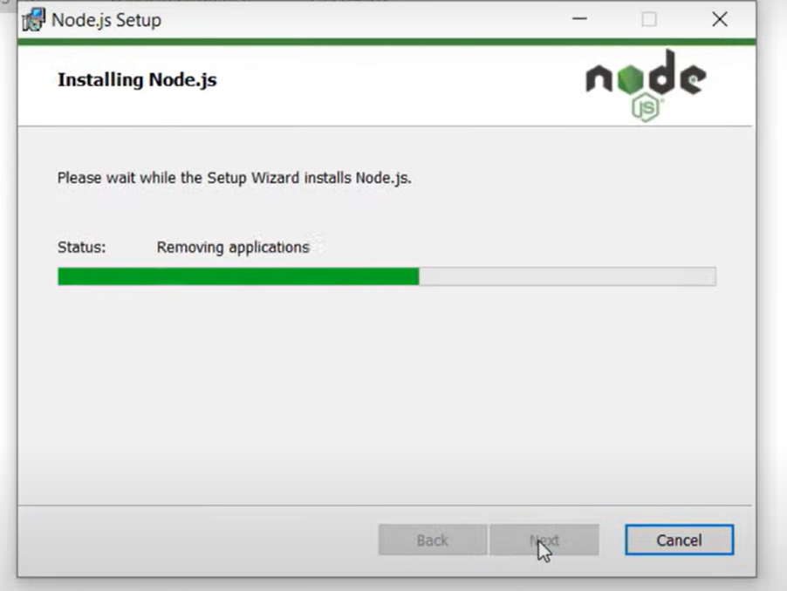

Slide 13
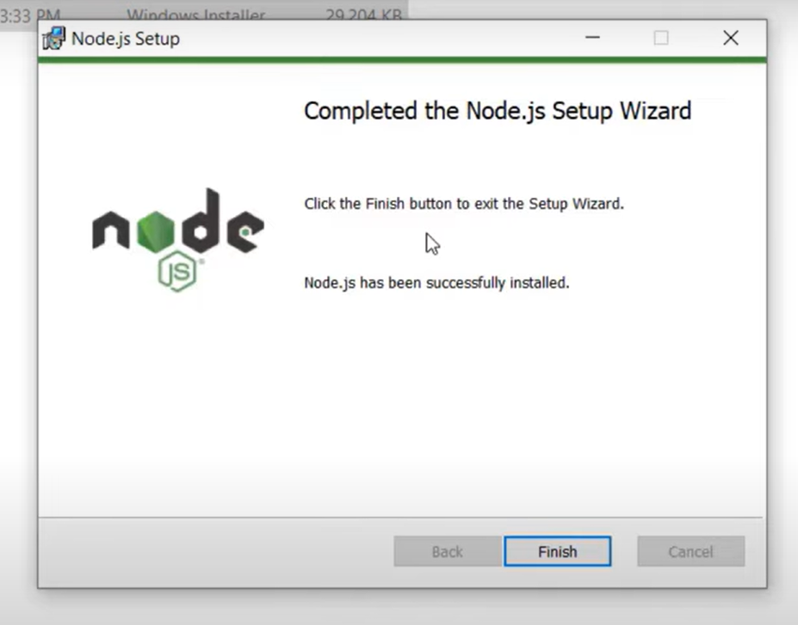

Slide 14
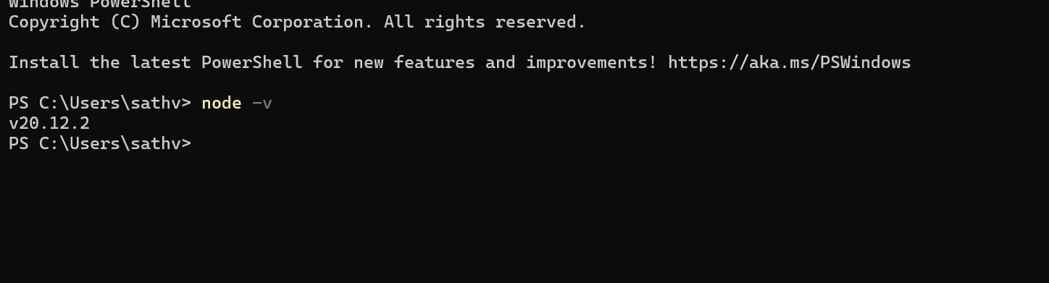

Slide 15
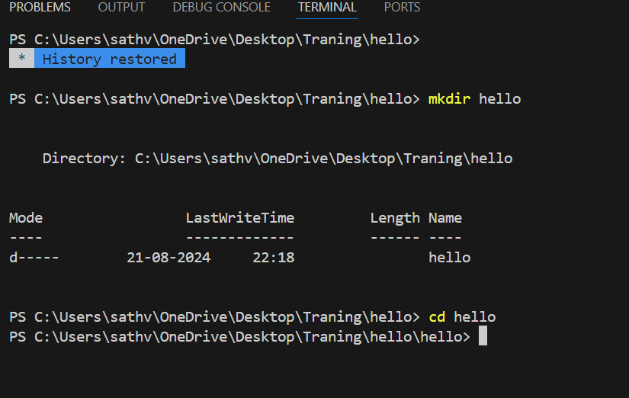
FIRST nodejs application
03

Slide 16
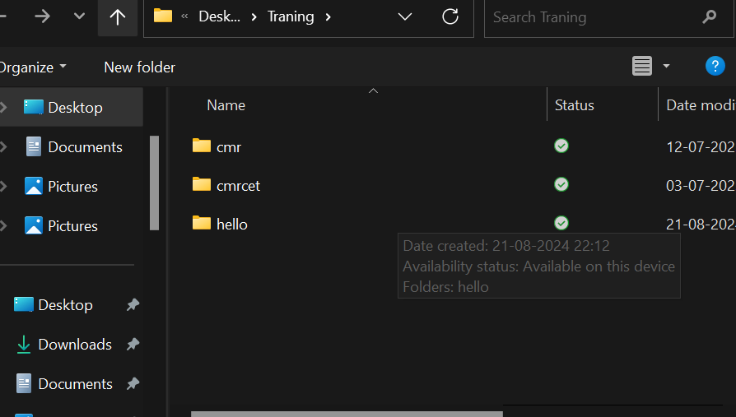
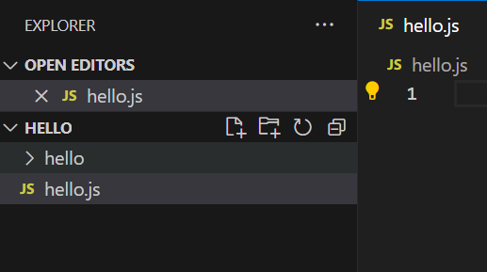
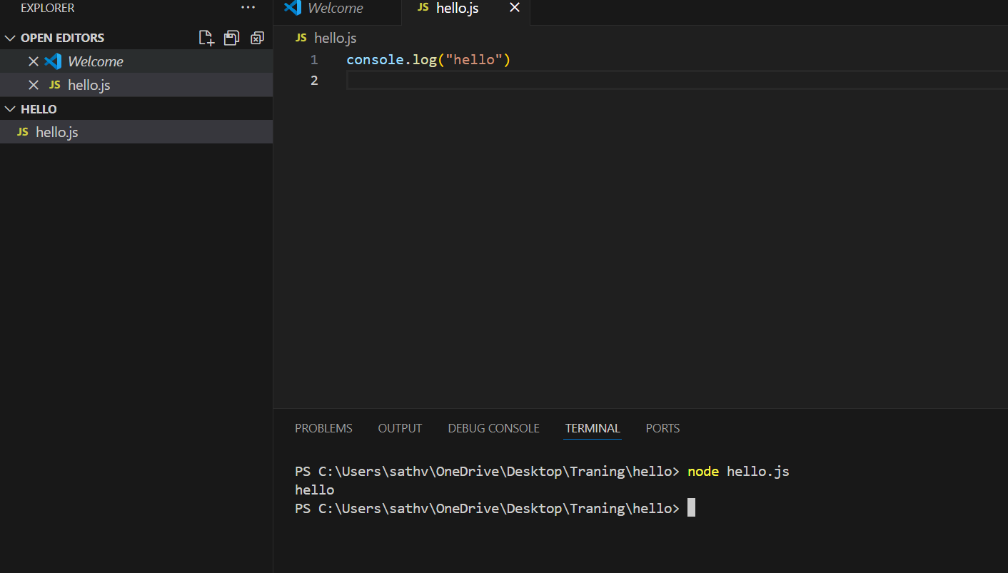

Slide 17
Popular Node.js Applications Express.js: Web application framework for Node.js. Socket.io: Real-time communication library. Meteor: Full-stack framework for building web and mobile apps. Electron: Framework for building cross-platform desktop apps.

Slide 18
CONCLUSION
04
In summary, Node.js has revolutionized server-side development by offering a lightweight, efficient, and scalable environment for building a wide range of applications. Its non-blocking, event-driven architecture makes it particularly suited for real-time applications, microservices, and streaming services. With a vast ecosystem of packages through NPM, Node.js empowers developers to quickly build robust and versatile solutions, from simple command-line tools to complex eCommerce platforms. As the demand for fast, scalable, and cross-platform applications continues to grow, Node.js remains a powerful tool in the modern developer's toolkit. Whether you're building web servers, APIs, IoT applications, or real-time systems, Node.js offers the performance and flexibility needed to create cutting-edge applications.

